Slide 1
How to Kivy App error show in your mobile
Very very easy step 😊

Slide 2
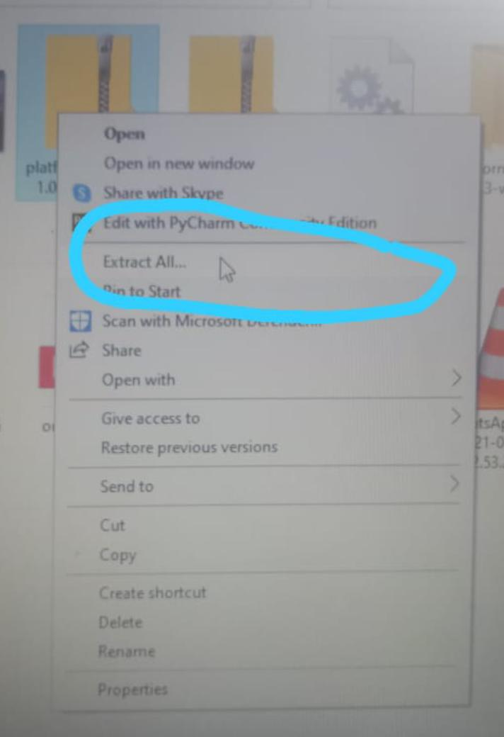

Step 1
First download this file your laptop👇
https://dl.google.com/android/repository/platform-tools-latest-windows.zip
Next Right click and extracted this zip file.

Slide 3
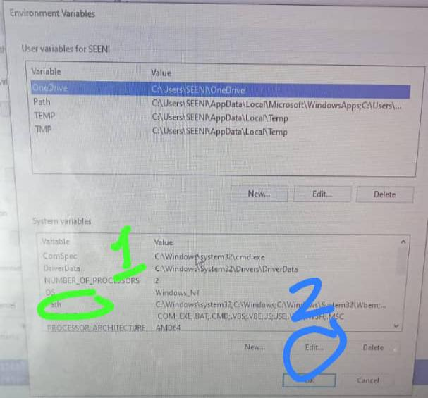
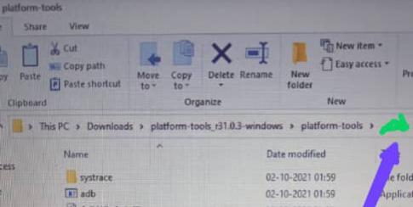
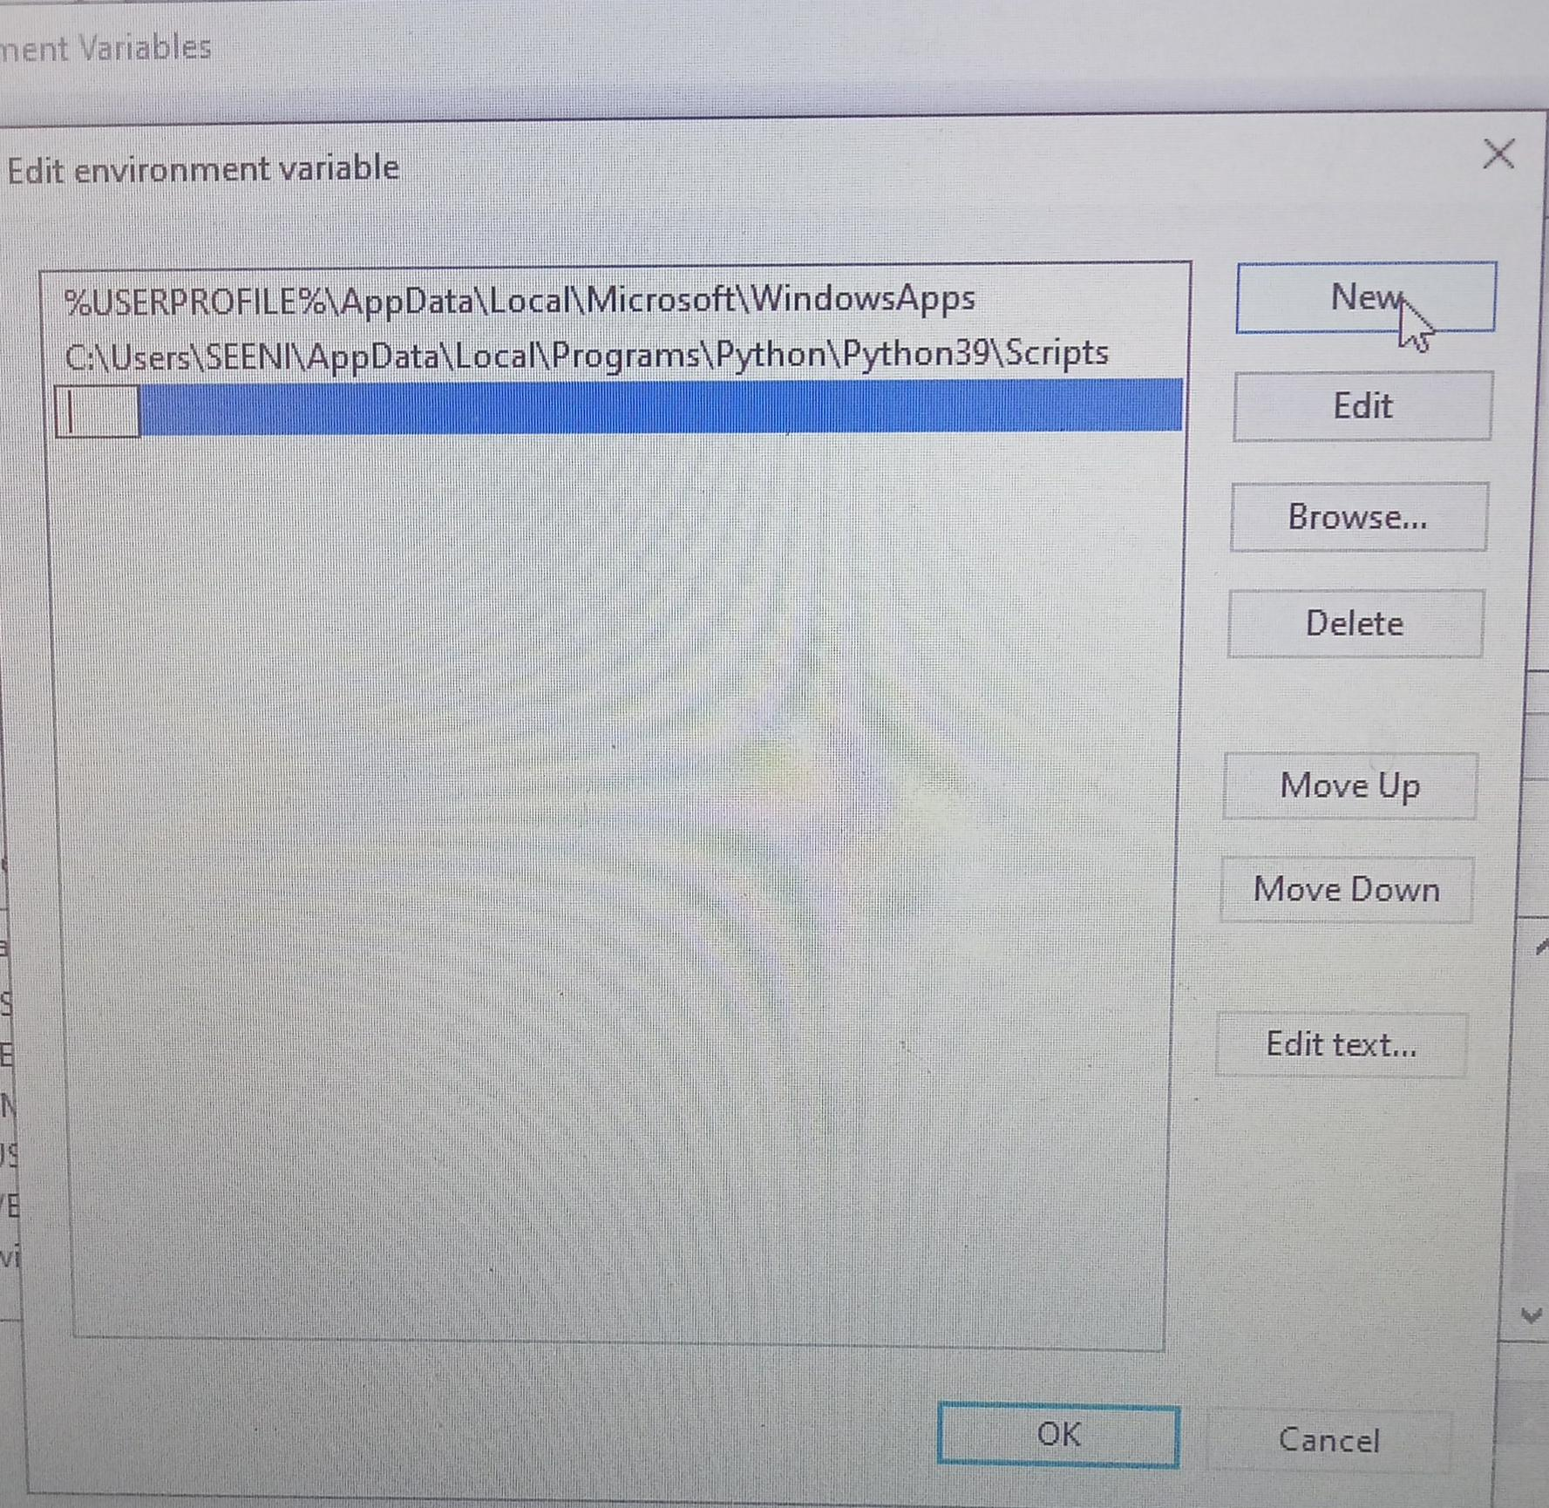
Step 2
Next Open file and capy path .
And Search windows for *environment variable*
First click path next click edit .
Then past this file path.

Slide 4

Step 3
Come the file and *Press* and *hold* the *Shift key* then *right-click* any area .
And click open power shell window here.
Type ./adb or adb
Next type *adb logcat -s python*
Enter and Press control+c.

Slide 5
Step 4
Take USB .conate the laptop .
And allow USB debugging.
*How to allow USB debugging*👇
https://youtu.be/KYLsoQR44VA
Then Type *adb devices* and hit enter.
Again type *adb logcat -s python* and enter
Next open your kivy app in your mobile any error show your mobile.

Slide 6
